Slide 1


Slide 2

Giovanni Seni

Slide 3
Distributed Learning of Rule Ensemble Models with H₂O

Slide 4
Timeline of Tree-based Ensembles
AdaBoost
Gradient Boosting
ISLE
Rule Ensembles
CART
Automatic variable subset selection
No data preprocessing needed
Missing value tolerant
Interpretable
1983
1997
Diversity by perturbing data distribution via observation weights
2000
Generalization to any differentiable loss function
2003
Generic ensemble generation
2008
Linear and non-linear basis functions
More interpretable
Diversity by perturbing data distribution via resampling
Bagging plus algorithm randomizing via subset splitting
Makes REs practical on large data sets
1996
2001
2010
Bagging
Random Forest
GLMs via Coordinate Descent

Slide 5
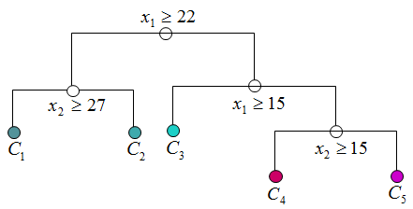
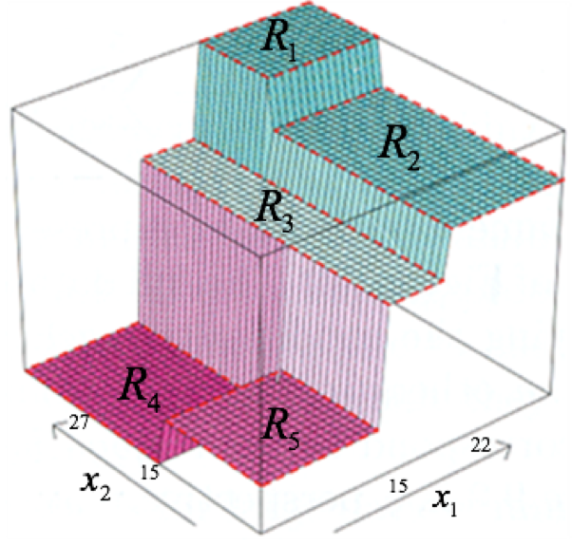
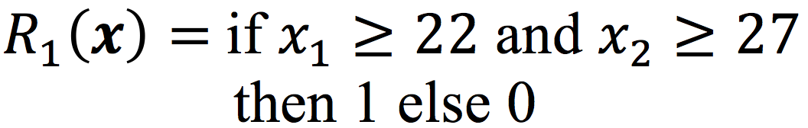
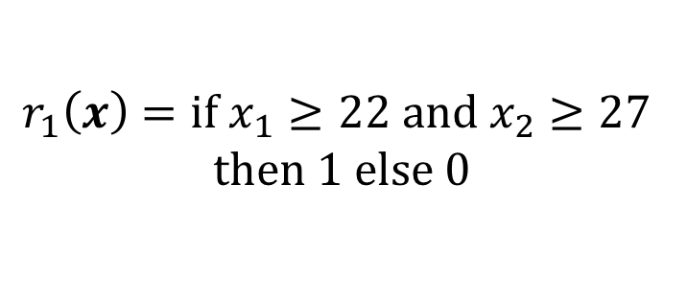
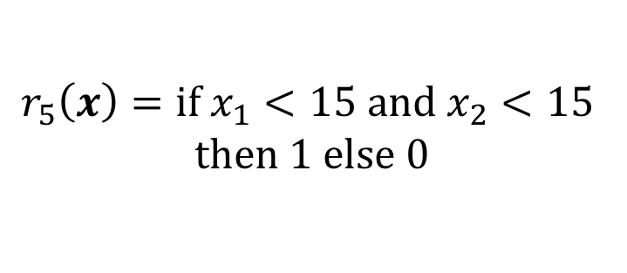
Trees as collection of rules
Decision trees can be decomposed into rules, each defining a hyper-region
$$r_{1}\left(x\right)=if x_{1}≥22 and x_{2}≥27$$
$$then 1 else 0$$
$$r_{5}\left(x\right)=if x_{1}<15 and x_{2}<15$$
$$then 1 else 0$$
...
...

Slide 6

Rule Ensembles (Friedman & Popescu, 2008)
Model combines base learners from two different families:
Once the rules have been generated, the coefficients are fit using a linear regularized procedure:
Capture non-linearities and interactions
Purely linear terms (as in Logistic Regression)

Slide 7
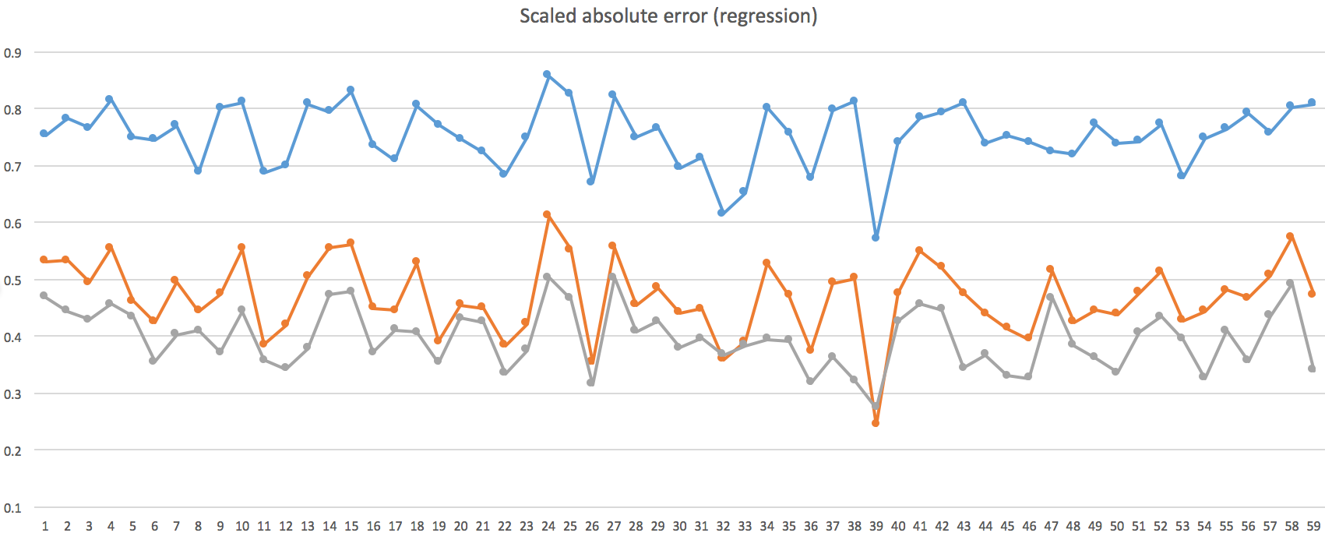
Performance Comparison
Performance comparison across 60 regression datasets between Random Forest (top), GBM (middle) and Rule Ensembles (bottom)

Slide 8
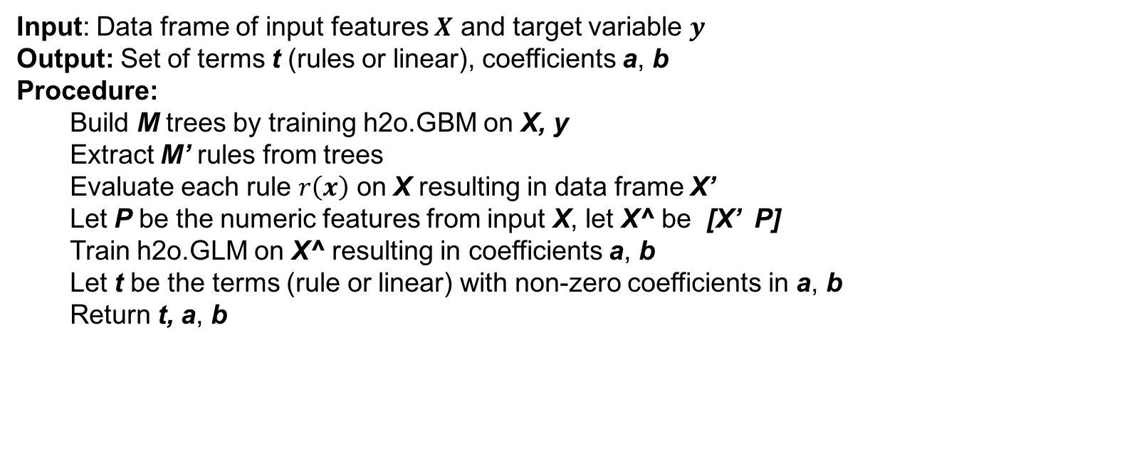
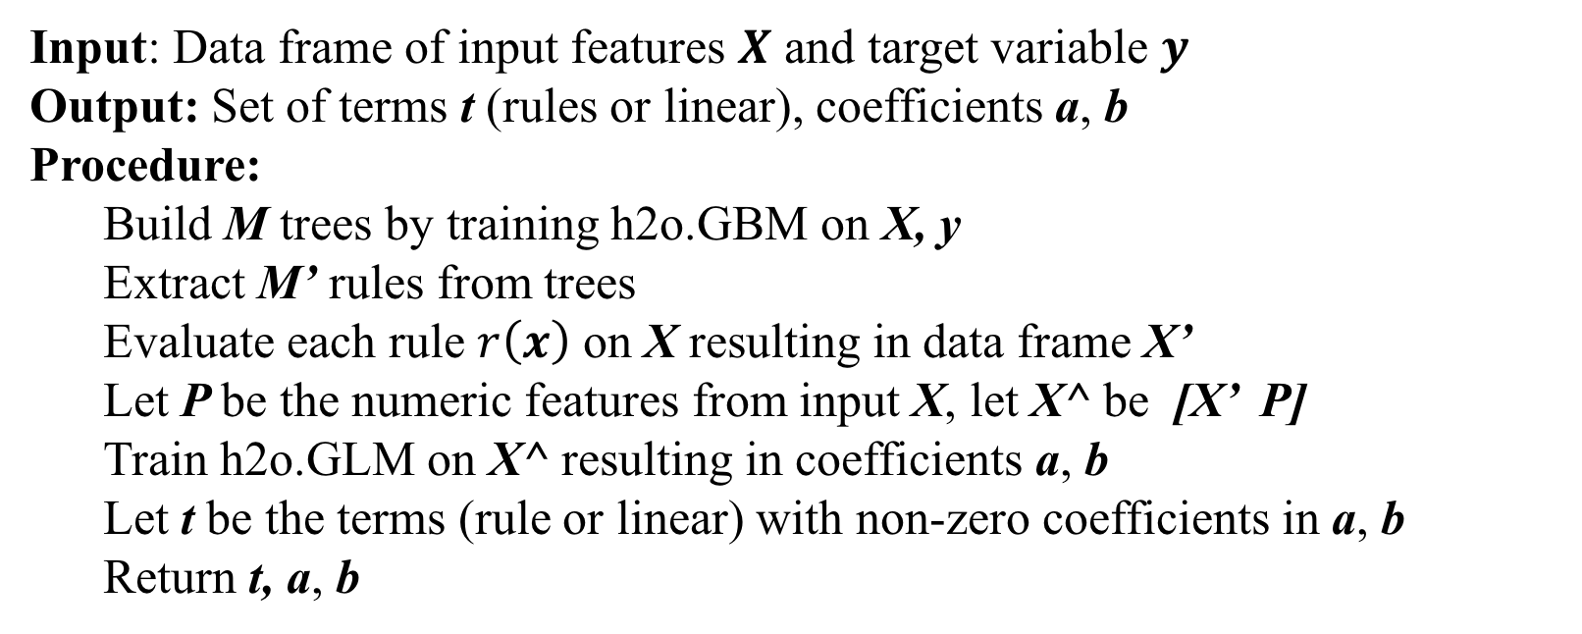
Rule Ensembles with H₂O
Pseudo-algorithm:
Input: Data frame of input features $X$ and target variable $y$
Output: Set of terms t (rules or linear), coefficients a, b
Procedure:
Build M trees by training h2o.GBM on X, y
Extract M’ rules from trees
Evaluate each rule $r\left(x\right)$ on X resulting in data frame X’
Let P be the numeric features from input X, let X^ be [X’ P]
Train h2o.GLM on X^ resulting in coefficients a, b
Let t be the terms (rule or linear) with non-zero coefficients in a, b
Return t, a, b
Input: Data frame of input features $X$ and target variable $y$
Output: Set of terms t (rules or linear), coefficients a, b
Procedure:
Build M trees by training h2o.GBM on X, y
Extract M’ rules from trees
Evaluate each rule $r\left(x\right)$ on X resulting in data frame X’
Let P be the numeric features from input X, let X^ be [X’ P]
Train h2o.GLM on X^ resulting in coefficients a, b
Let t be the terms (rule or linear) with non-zero coefficients in a, b
Return t, a, b

Slide 9
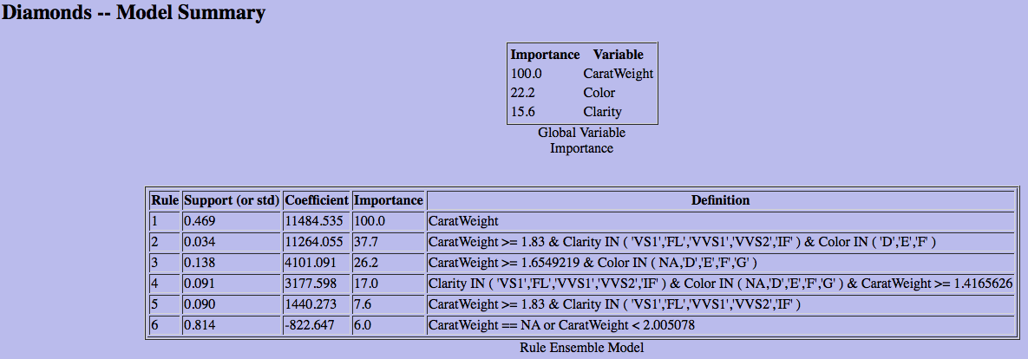
Rule Ensembles with H₂O Sample Output
Linear Term
Rule Term
Input: Data frame of input features $X$ and target variable $y$
Output: Set of terms t (rules or linear), coefficients a, b
Procedure:
Build M trees by training h2o.GBM on X, y
Extract M’ rules from trees
Evaluate each rule $r\left(x\right)$ on X resulting in data frame X’
Let P be the numeric features from input X, let X^ be [X’ P]
Train h2o.GLM on X^ resulting in coefficients a, b
Let t be the terms (rule or linear) with non-zero coefficients in a, b
Return t, a, b

Slide 10
Rule Ensembles with H₂O Extract rules from trees
Pseudo-algorithm:
Input: GbmMojoModel model
Output: List of rules in JSON format
Procedure:
rules = {}
Foreach tree T in model {
TreeGraph g = T.computeGraph()
rules.append(Traverse g, generating a rule for every node)
}
Return rules
Input: Data frame of input features $X$ and target variable $y$
Output: Set of terms t (rules or linear), coefficients a, b
Procedure:
Build M trees by training h2o.GBM on X, y
Extract M’ rules from trees
Evaluate each rule $r\left(x\right)$ on X resulting in data frame X’
Let P be the numeric features from input X, let X^ be [X’ P]
Train h2o.GLM on X^ resulting in coefficients a, b
Let t be the terms (rule or linear) with non-zero coefficients in a, b
Return t, a, b

Slide 11
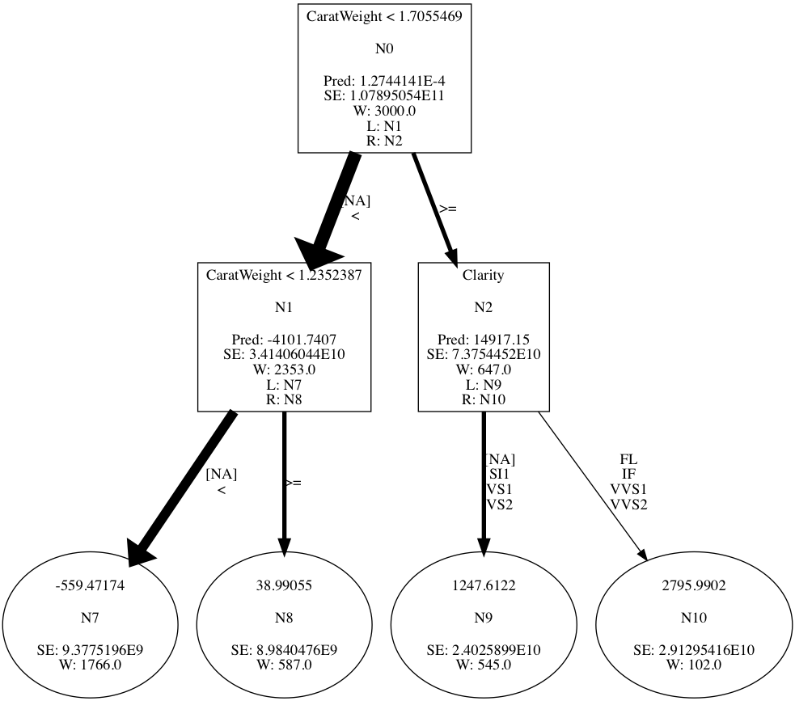
Rule Ensembles with H₂O Extract rules from trees (cont.)

Slide 12
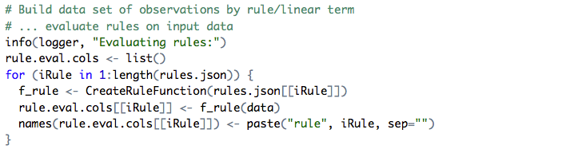
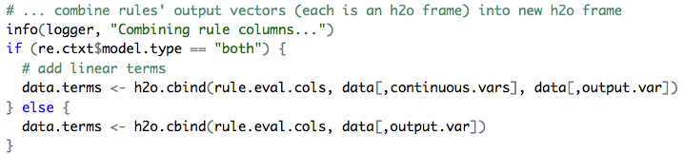
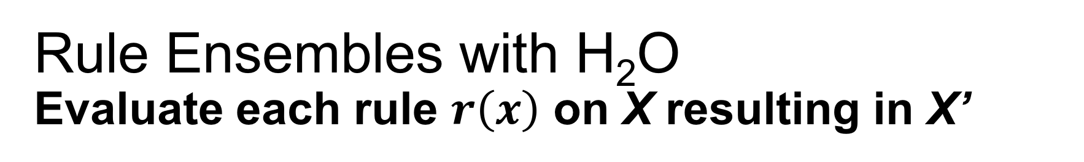
Rule Ensembles with H₂O Evaluate each rule $r\left(x\right)$ on X resulting in X’
R code:

Slide 13
Deployment in Production
Use SQL as the model definition language
Batch scoring ==> rely on SQL engine
Online scoring ==> optimized Java-based RE runner
intercept
Rule term
Linear term

Slide 14
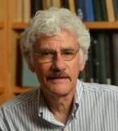
Acknowledgements
Prof. Jerome H. Friedman
James Bishop
Xiaoyu Dai

Slide 15
Demo

